Slide 1

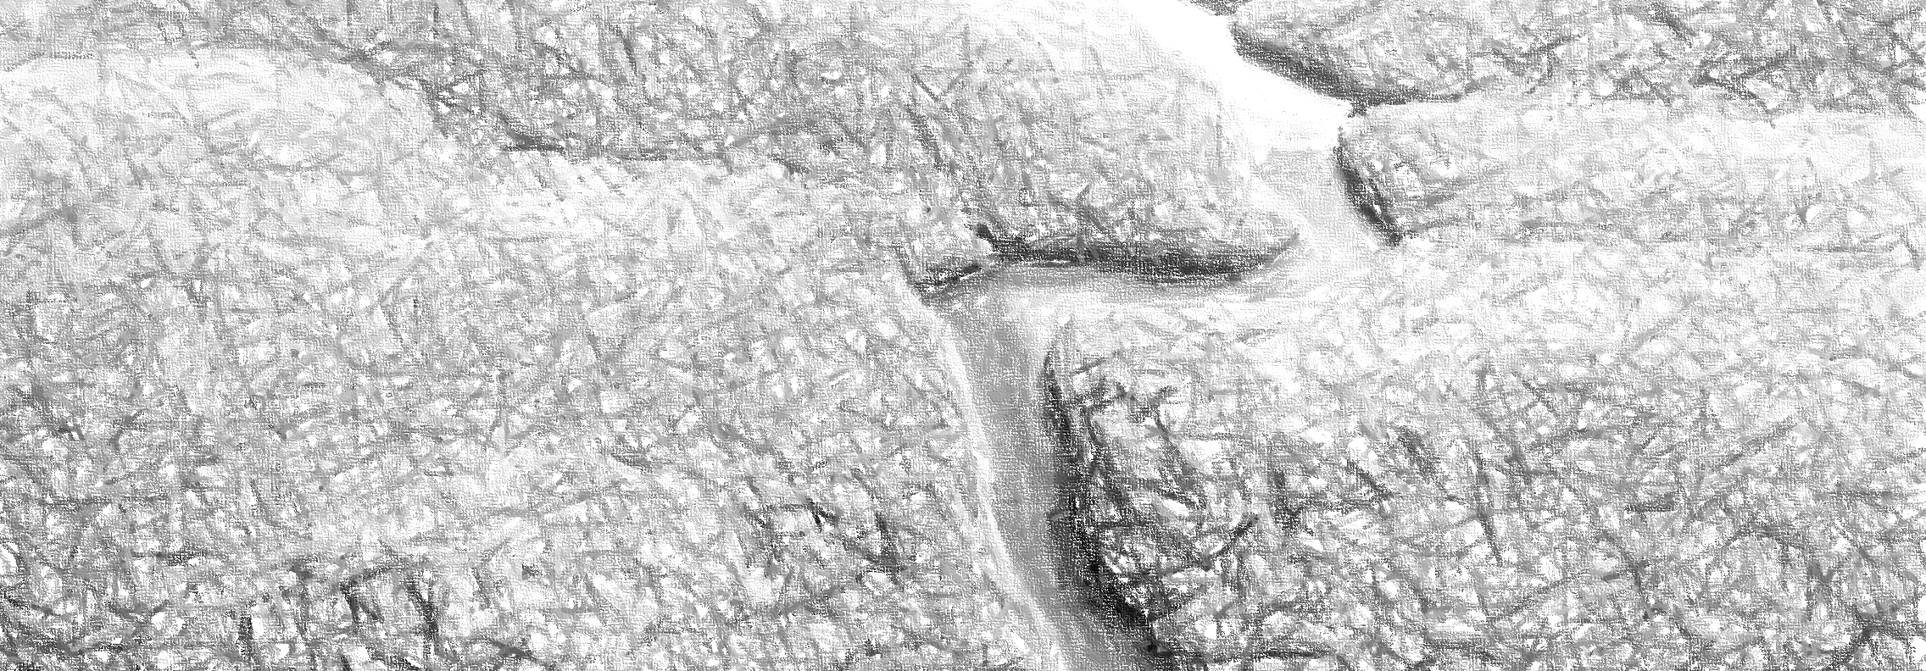
Visualising a river to support a community

Slide 2
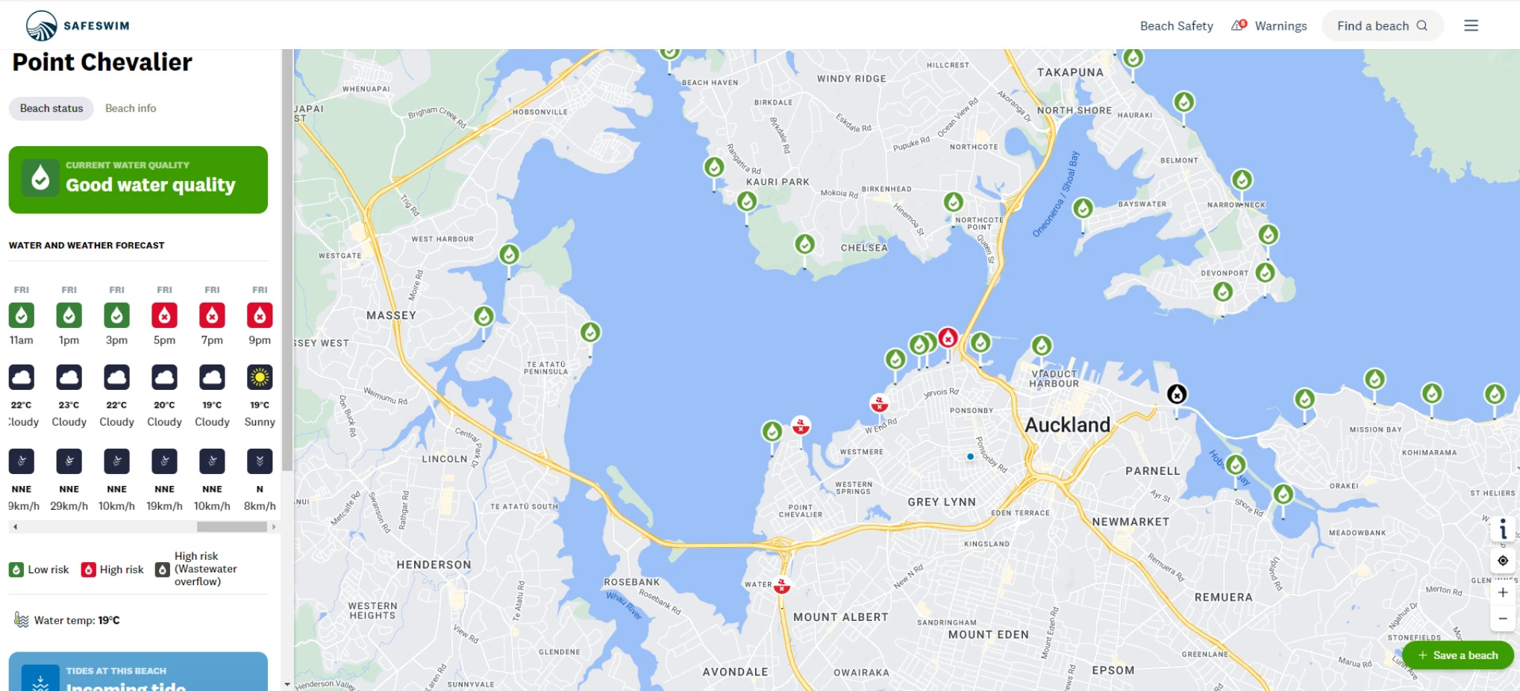

New Zealand WaterCare
Map-based real-time alerts
https://safeswim.org.nz/

Slide 3
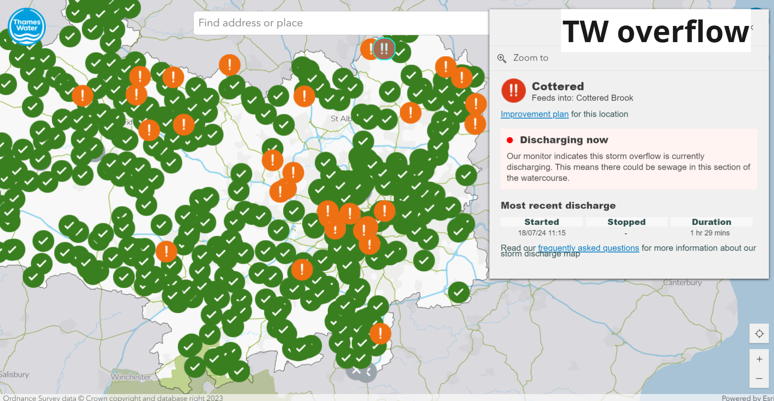

Thames Water Overflow
Map-based overflow alerts
https://www.thameswater.co.uk/edm-map#storm-discharge-map

Slide 4
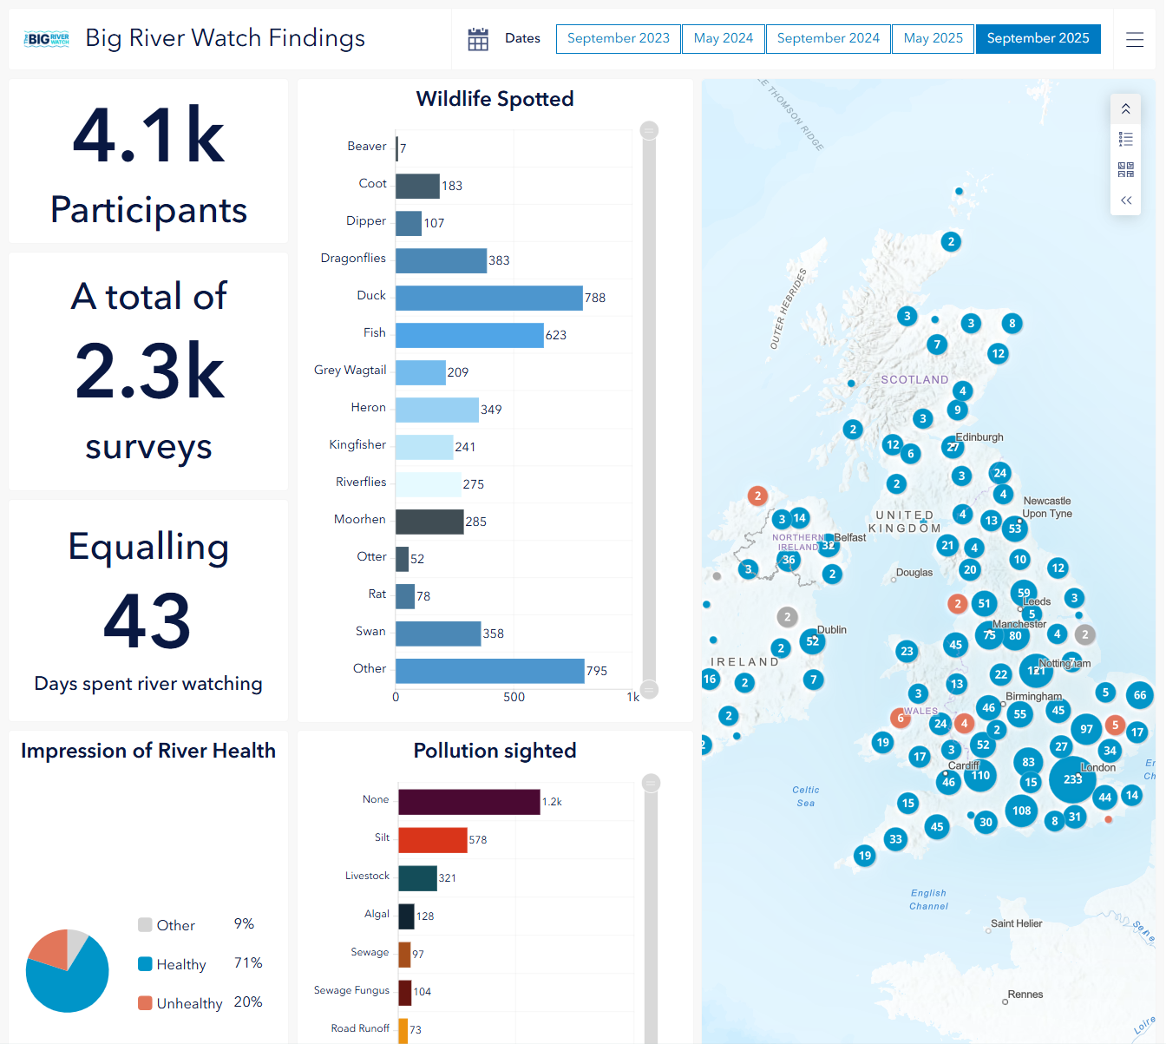

Standard dashboard
Big River Watch Data Explorer | The Rivers Trust

Slide 5
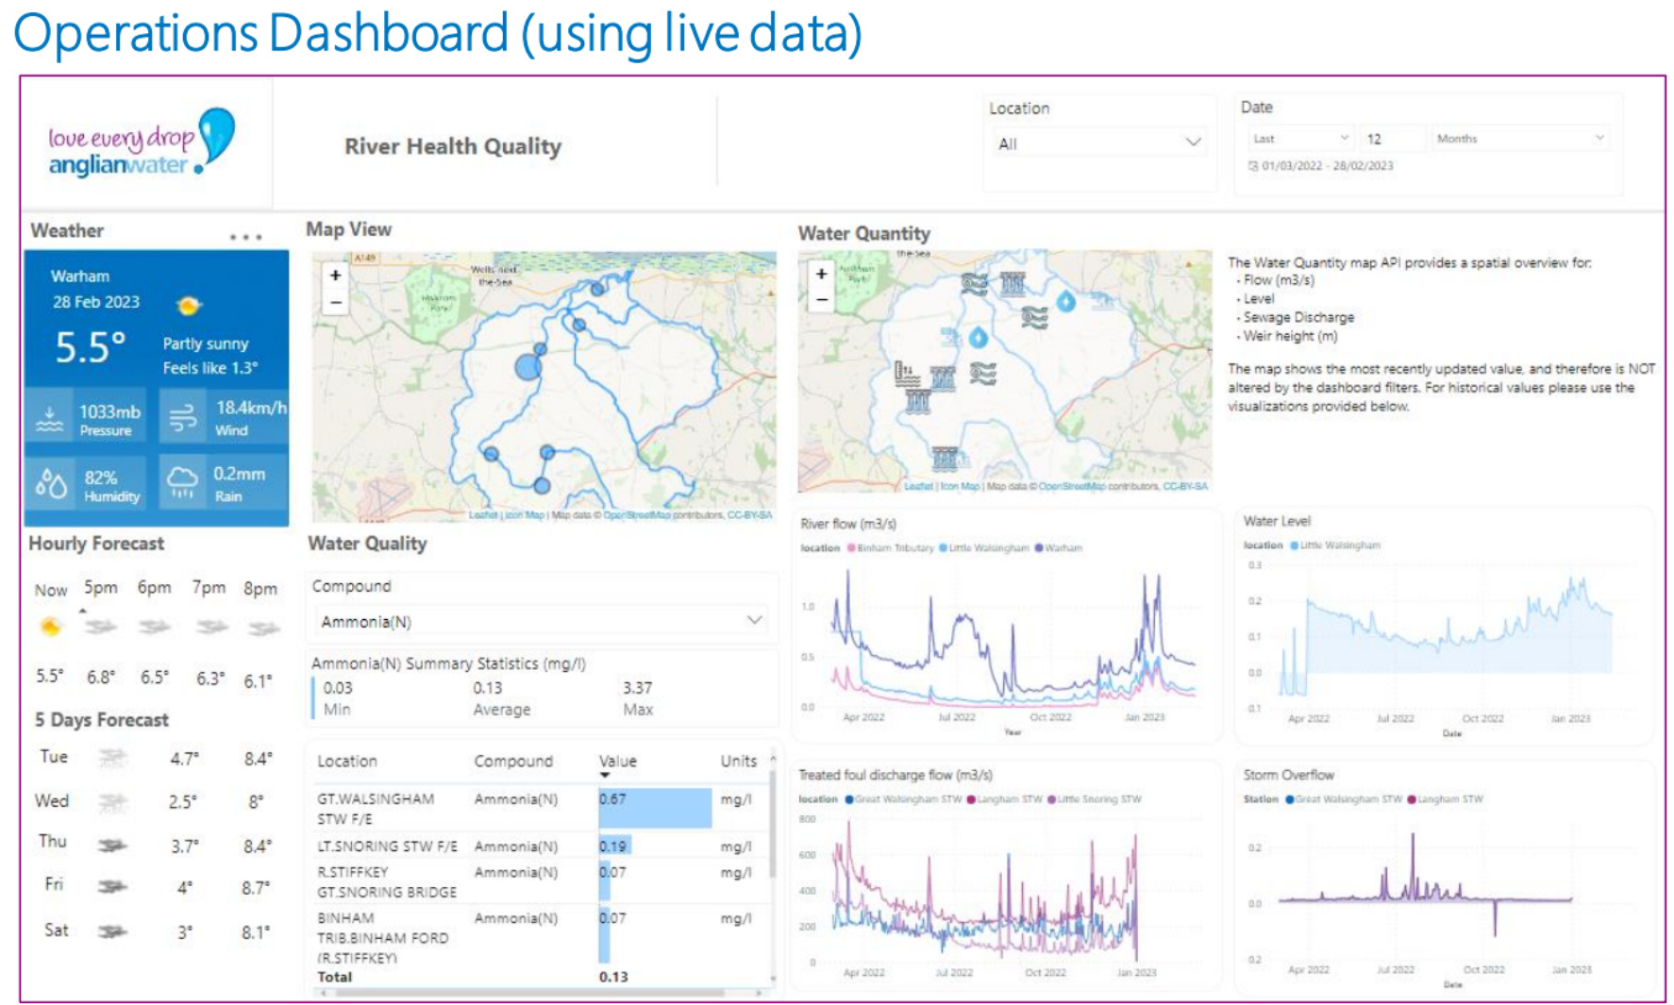
River Stiffkey – Anglian Water
Standard dashboard

Slide 6
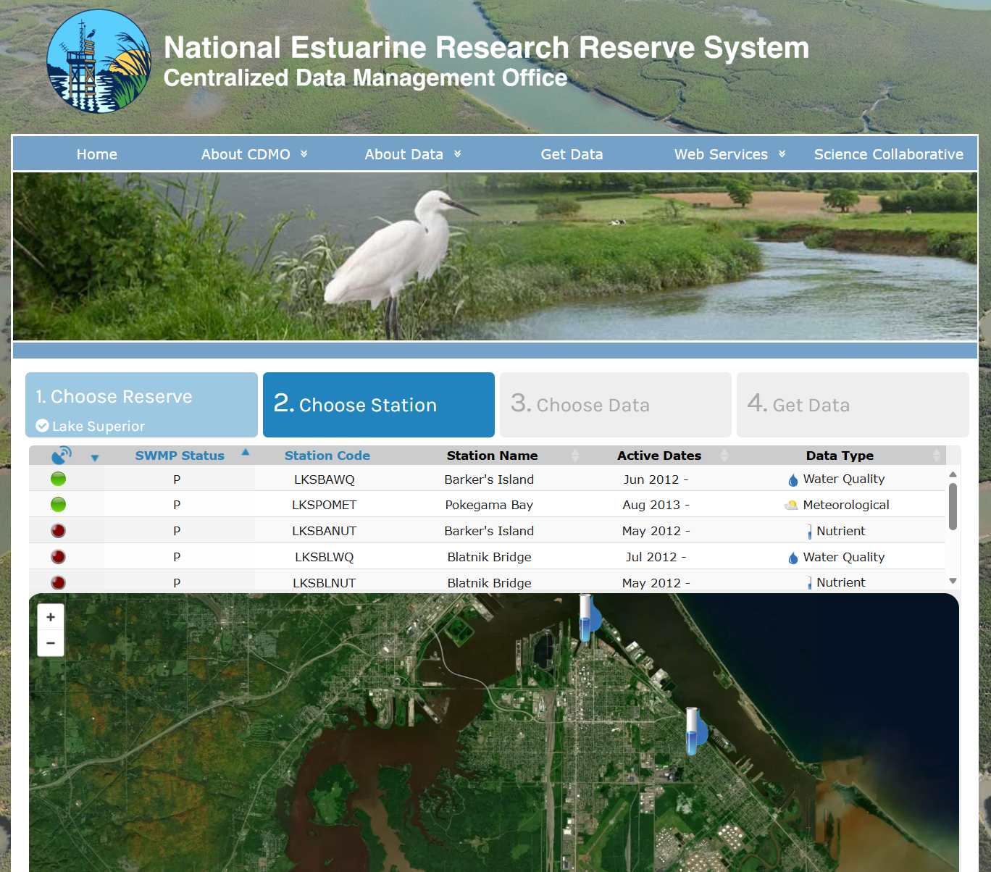

Choose-your-own data
Centralized Data Management Office | Data Export System

Slide 7
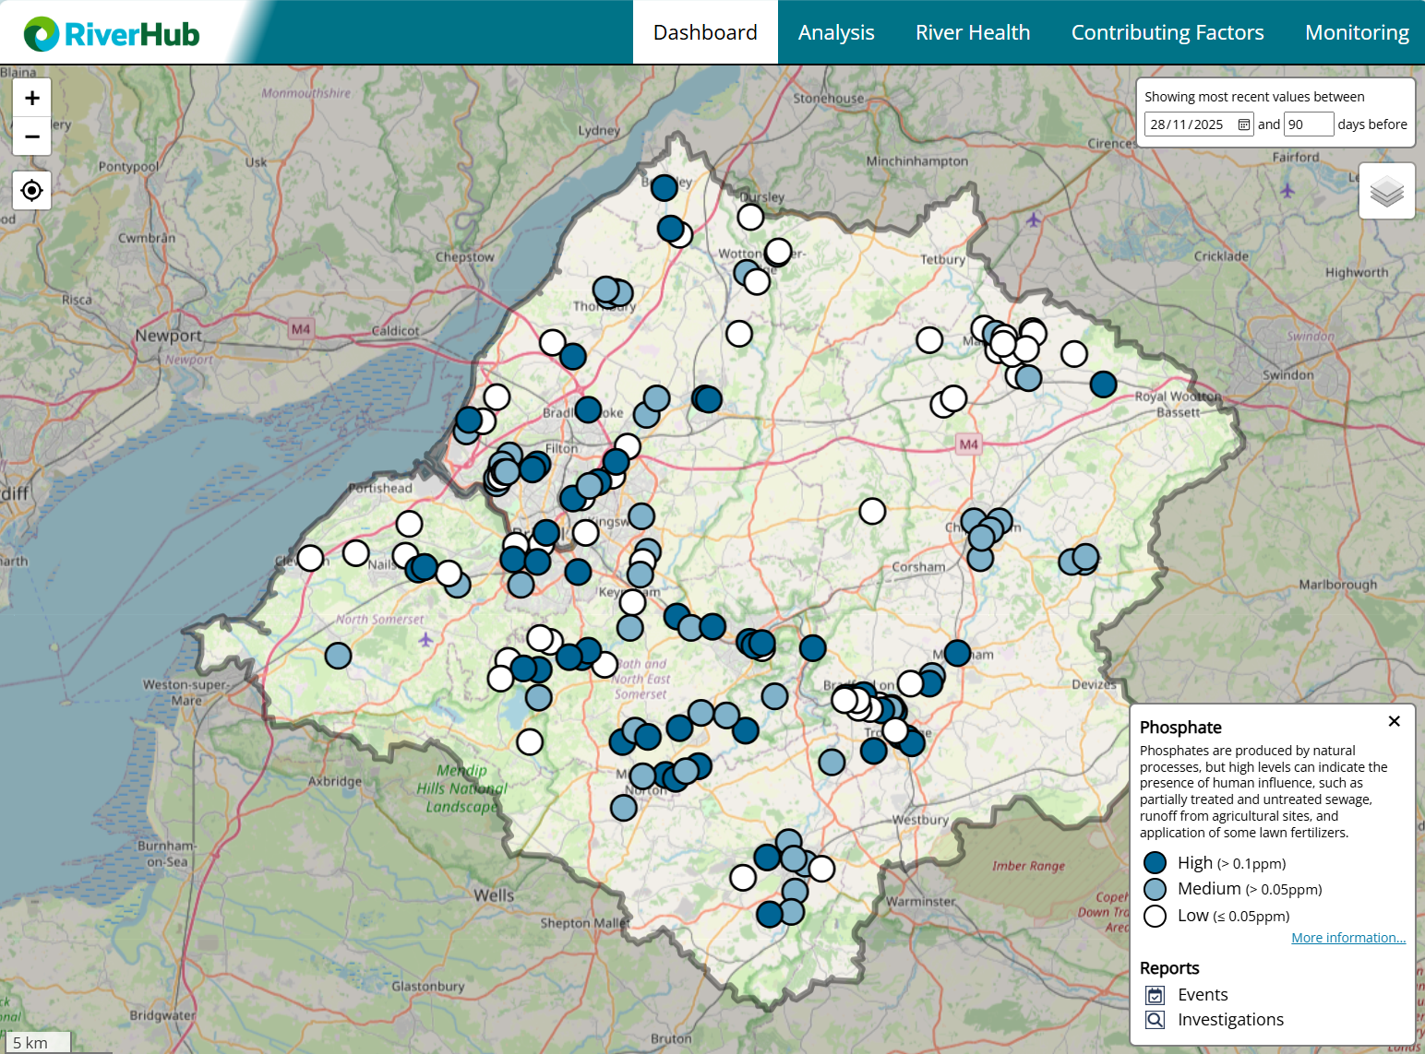

Dashboard page
Web page approach
https://riverhub.co.uk/
Notes:
https://riverhub.co.uk/

Slide 8
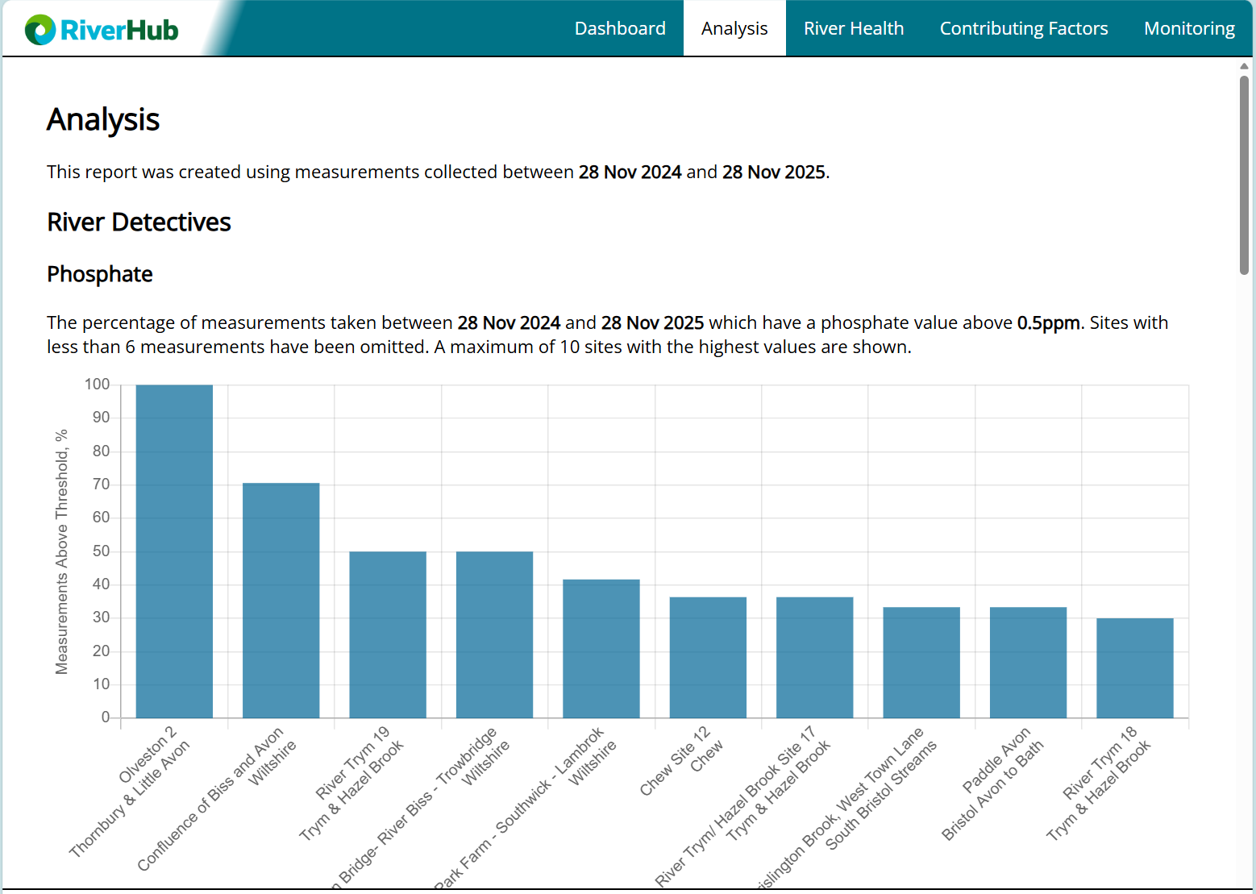
Analysis page
Web page approach
https://riverhub.co.uk/

Slide 9
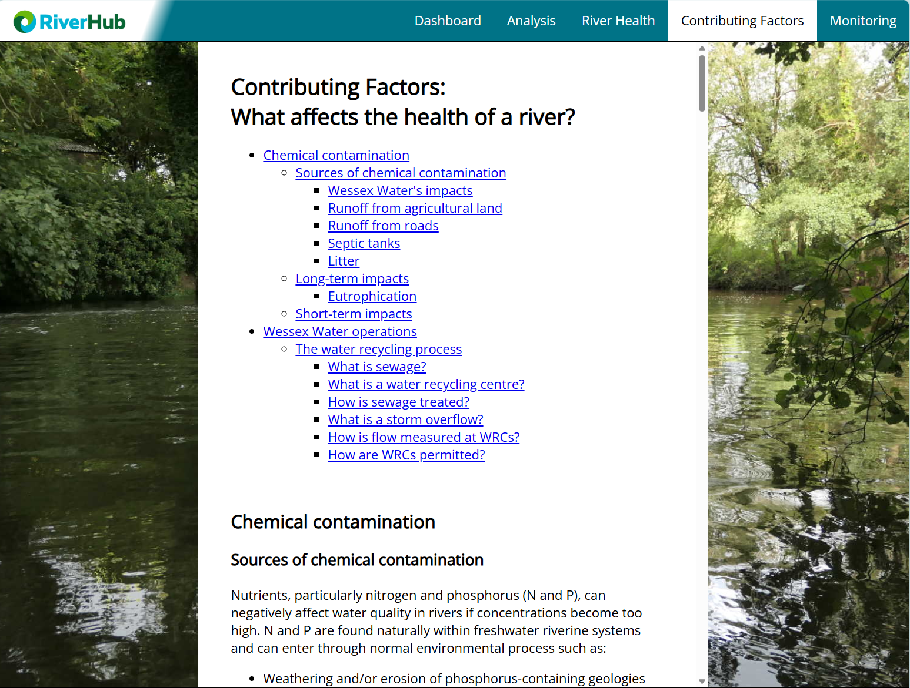
Contributing factors page
Web page approach
https://riverhub.co.uk/

Slide 10
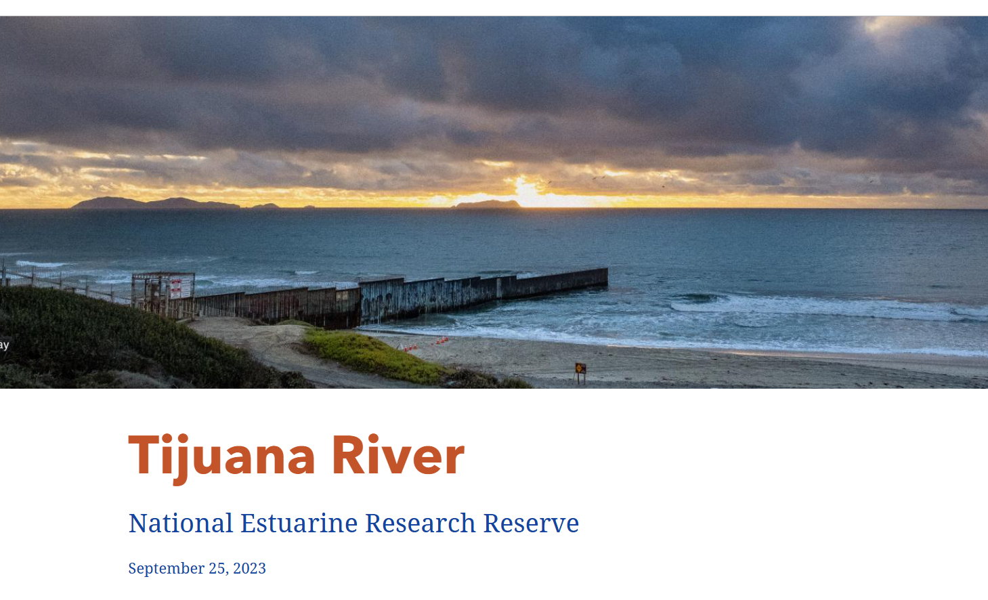
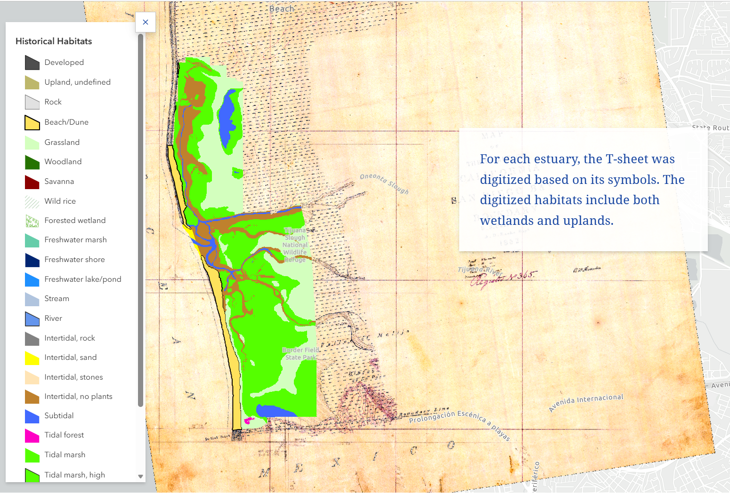

An ArcGIS story approach
Tijuana River

Slide 11
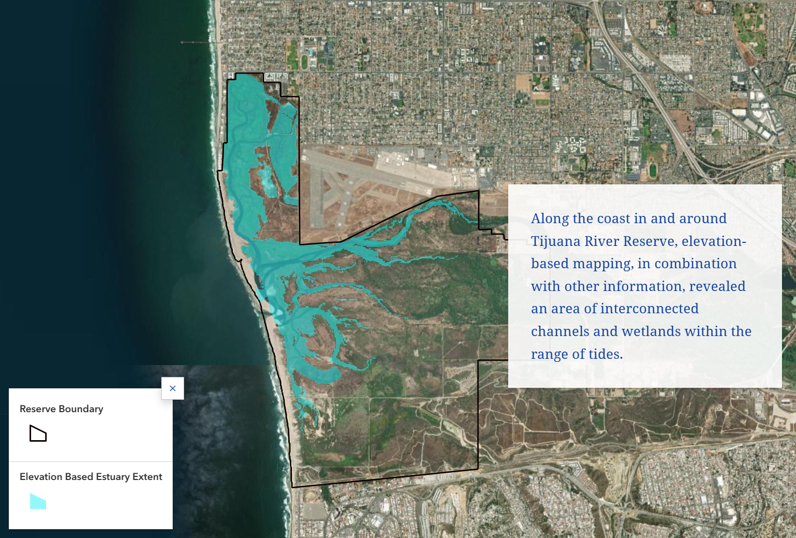
An ArcGIS story approach
Tijuana River

